Slide 1
Use Case Considerations
PROJECT PACIO

Slide 2
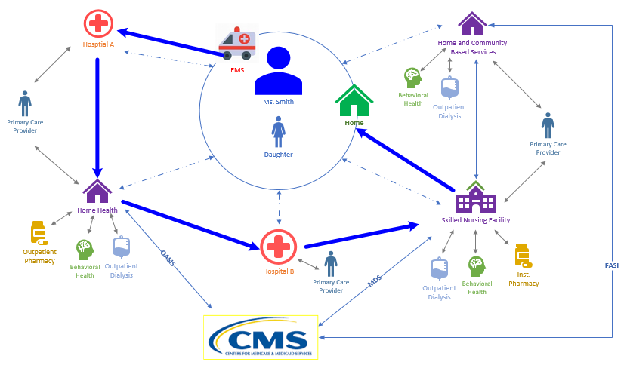
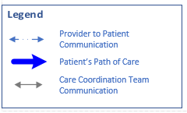
Patient Story

Slide 3
“Mega Rule”
Medicare and Medicaid Programs; Reform of Requirements for Long-Term Care Facilities (page 46)
Minimum data to be sent when a person transitions between settings:
Contact information of the practitioner responsible for care
Resident representative information including contact information
Advance Directive information
Special instructions or precautions for ongoing care
Resident’s comprehensive care plan goals
All other necessary information, including a copy of the resident’s discharge summary, consistent with § 483.21(c)(2), as applicable, and any other documentation, as applicable, to ensure a safe and effective transition of care
discharge summary mentioned above must include the medication reconciliation, as well as a recapitulation of the resident’s stay, a final summary of the resident’s status, and the post-discharge plan of care
Notes:
https://www.govinfo.gov/content/pkg/FR-2016-10-04/pdf/2016-23503.pdf

Slide 4
Baseline Care Plan- Patient Summary
“Therefore, in an effort to further promote a resident’s right to be informed, while balancing the burden imposed on facilities, we have revised § 483.21(a)(3) to require facilities to provide residents and their resident representatives with a summary of their baseline care plan. This summary must include, but is not limited to,
the initial goals of the resident;
a summary of the resident’s medications and dietary instructions;
any services and treatments to be administered by the facility and personnel acting on behalf
of the facility; and
any updated information based on the details of the comprehensive care plan, as necessary.”
Notes:
https://www.govinfo.gov/content/pkg/FR-2016-10-04/pdf/2016-23503.pdf (Page 24)

Slide 5
Baseline Care Plan- 48 hours
CMS “proposed to require that the baseline care plan be completed within 48 hours of a resident’s admission. At § 483.21(a)(1)(ii), we proposed to list the information that would, at a minimum, be necessary for inclusion in a baseline care plan, but would not limit the contents of the care plan to only this information. In the proposed rule, we indicated that information such as
Initial goals based on admission orders,
Physician orders,
Dietary orders,
Therapy services,
Social services, and
PASARR recommendations as appropriate
would be the type of information that would be necessary to provide appropriate immediate care for a resident. However, since care plans are developed specifically for each resident, a facility could decide to include additional information as appropriate.

Slide 6
IMPACT Act Requirements
Data Must be Interoperable
Quality Measures
Functional Status
Skin Integrity
Medication Reconciliation
Incidence of Major Falls
Transfer of Health Information
Other Measures
Medicare Spending per Beneficiary
Discharge to Community
Potentially Preventable Hospital Readmissions
Standardized Data Submission
Admission and Discharge
Functional status
Cognitive function and mental status
Special services, treatments, and interventions
Medical conditions and co-morbidities
Impairments
Other categories required by the Secretary

Slide 7
IRF, SNF, LTCH Proposed Rules
Standardized Patient Assessment Data Elements (SPADEs) across instruments
Transfer of Health Information (Reconciled Med list to patient; Reconciled Med List to next provider)
Function (e.g., self care and mobility)
Cognitive function (e.g., express & understand ideas; mental status, such as depression and dementia- BIMS, CAM, PHQ)
Special services, treatments, and interventions (e.g., need for ventilator, dialysis, chemotherapy, and total parenteral nutrition)
Medical conditions and co-morbidities (e.g., Pain interference)
Impairments (e.g., incontinence; impaired ability to hear, see, or swallow)
Other categories as deemed necessary by the Secretary:
SDOH (e.g.- Race, Ethnicity, Preferred Language, Interpreter Services, Health Literacy, Transportation, Social Isolation)
Notes:
https://www.cms.gov/Medicare/Quality-Initiatives-Patient-Assessment-Instruments/NursingHomeQualityInits/Downloads/Proposed-Specifications-for-SNF-QRP-Quality-Measures-and-SPADE.pdf

Slide 8
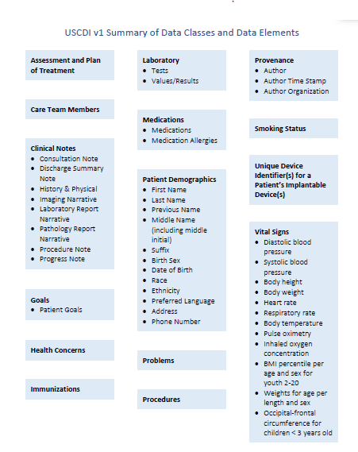
Proposed USCDI Data Classes

Slide 9
USCDI “Plus PAC”
Patient name
Sex
Date of birth
Race
Ethnicity
Preferred language
Smoking status
Problems
Medications
Medication allergies
Laboratory test(s)
Laboratory value(s)/result(s)
Vital signs
Procedures
Care team member(s)
Immunizations
Unique device identifier(s) for a patient's implantable device(s)
Assessment and Plan of Treatment
Goals
Health concerns
Provenance
Clinical Notes
“Plus PAC”
Functional Status (Eating, mobility, etc..)
Cognitive Status (BIMS, CAM, PHQ)
Skin Integrity (pressure ulcers)
Falls
Family/Care giver information and contact info
Special instructions (e.g.-Infection protocol)
Advance Directives

Slide 10
Advance Directives Focused Use Case Scenario
Project pacio

Slide 11
Patient
Ms. Smith and her perspective

Slide 12
Social History
Ms. Smith is a 68 year old white female widow
Retired 3 years ago
Moved from Maryland to Texas.
Prior to her retirement, she worked as a receptionist in a hotel lobby
Depends on her social security check as her primary source on income
Patient lives alone
Remain independent in her Activities of Daily Living (ADLs)
Functionally independent with a cane
Drives her own car to get to medical appointments
Sometimes reliant on friends to drive her, due to intermittent dyspnea and blurry vision in her right eye
She has two children, a son and a daughter, who still reside in Maryland
Daughter works as an accountant, is married and has children
Son lives alone and works as a lawyer
Communication is poor between family members and Ms. Smith rarely discusses her healthcare with them

Slide 13
Medical History
PAST MEDICAL HISTORY
Patient leads a sedentary lifestyle and follows a poor diet with little exercise, which is a result of low health literacy, poor social support and multiple comorbidities. Patient has also started to experience frequent falls due to the osteoarthritis of the right hip. Patient was diagnosed with the following while she was in Maryland:
• Hypertension • Depression
• Hyperlipidemia • Cataracts
• Stage 3 chronic kidney disease • Osteoarthritis
• Ischemic heart disease • Type II diabetes

Slide 14
Current Medications
Patient has a complex medication regimen, which contributes to poor adherence.
• Lisinopril 40mg twice a day • Glargine 24 units SQ nightly
• Atorvastatin 40mg nightly • Insulin 3 units with each meal
• Calcium 500mg daily • Sertraline 25mg nightly
• Vitamin D 800IU daily • Tylenol 650mg every 6 hours or as needed
• Furosemide 20mg daily
• Ferrous Sulfate 325mg three times a day prior to meals

Slide 15
Typical Healthcare Follow Up
Patient does follow up with the primary care physician (PCP) and nephrologist regularly, but other specialist follow up is often sporadic. The PCP has been central to the patient’s healthcare information management.
• PCP • Cardiologist
• Endocrinologist • Nephrologist
• Psychiatrist • Ophthalmologist
• Retail Pharmacy • Lab Services

Slide 16
Encounter with PCP
PCP asked Ms. Smith if she had Advance Directives
Ms. Smith responded “yes, but they are on paper and at home”. She further explained that the Advance Directives were the “Maryland Advance Directives”
Ms. Smith was unable to recall the complete content of her advance directives because five years had lapsed since she had last reviewed it. She did recall wanting to minimize aggressive treatments if she was in a vegetative state.
http://www.marylandattorneygeneral.gov/Health%20Policy%20Documents/adirective.pdf
https://hhs.texas.gov/laws-regulations/forms/advance-directives
Notes:
http://www.marylandattorneygeneral.gov/Health%20Policy%20Documents/adirective.pdf
https://hhs.texas.gov/laws-regulations/forms/advance-directives

Slide 17
Advance Directives Information
Advance directives may have varying titles or use different terminology in different states
One state’s advance directive may or may not be recognized in another state
Advance directives do not expire and will remain in effect until changed by the patient
Content in the advance directives may differ slightly (some states may provide a space for special requests such as organ donation and burial plans)
For the advance directives to be valid, they must be signed with witnesses and/ or be notarized (states differ with their practices)
Notes:
Avoid devolving into a discussion of whether family members with medical power of attorney have authority to override the patient’s advance directives and/or whether advance directives should be incorporated into physician’s orders.

Slide 18
Ms. Smith’s Concerns
Concerns
I wish there was an easy way to access and update my advance directives.
If I am unexpectedly admitted to the hospital, how will they know that I have advance directives and what they are?
Do I need to provide a copy of my advance directives to all my healthcare providers?
How do I make sure that my children have access to my most current version of advance directives?
Notes:
Ms. Smith has multiple concerns about her advance directives. She verbalizes the following (1)"I wish there was an easy way to access and update my advance directives", (2) "How do I make sure that my children have access to my most current version of advance directives?", (3) If I am unexpectedly admitted to the hospital, how will they know that I have advance directives and what they are?", (4) Do I need to provide a copy of my advance directives to all my healthcare providers?".

Slide 19
Ms. Smith would like…
Easy access to her advance directives through her smartphone
To provide access to her children regarding advance directives information
The ability to update advance directives information
To avoid having to recall and provide paper copies of her advance directives to multiple healthcare providers through the healthcare continuum
To have advance directives information cross state lines

Slide 20
Daughter
The perspective from the patient’s daughter

Slide 21
Daughter’s Concerns
Concerns
Mom doesn’t communicate all of her healthcare information with me
If Mom is incapacitated, how will I know what her advance directives are?
How will I know if Mom has made any changes to her advance directives?
Has Mom updated her advance directives after leaving Maryland?

Slide 22
Daughter Would Like…
To have easy access to her Mother’s advance directives in the event her mother is incapacitated
To be notified if the advance directives are updated

Slide 23
Provider
Provider perspective

Slide 24
Provider’s Concerns
Concerns
My EHR only stores advance directives information in a PDF
My EHR isn’t interoperable with the hospital EHRs, which makes it difficult to send advance directives information
If my patient is unexpectedly admitted to a hospital or another care setting, how will I be able to transmit information in a timely way?
I need to know if my patient has advance directives and access to the content

Slide 25
Provider would like…
To be able to retrieve advance directives in the EHR quickly and efficiently if the patient has them
To be able to send advance directives to other healthcare providers with minimal clicks
To be notified when the patient has advance directives
To be notified when the patient updates their advance directives

Slide 26
Payer
The payer perspective

Slide 27
Payer Concerns
Concerns
Do members have end of life preferences?
Advance directives can prevent unwanted aggressive healthcare interventions
Do providers know what the members end of life preferences are?
Reducing end of life cost of care for members

Slide 28
Payer would like…
To have members be engaged in end of life planning
To encourage members to have advance directives and providers to have easy access to them

Slide 29
Functional Status Focused Use Case Scenario
TUNE in NEXT WEEK!

